Slide 1

SENTIMENT ANALYSIS FOR MARKETING

Slide 2
Sentiment Analysis is a Marketing
SENTIMENT ANALYSIS IS A MARKETING TOOL THAT HELPS YOU EXAMINE THE WAY PEOPLE INTERACT WITH A BRAND ONLINE. THIS METHOD IS MORE COMPREHENSIVE THAN TRADITIONAL ONLINE MARKETING TRACKING, WHICH MEASURES THE NUMBER OF ONLINE INTERACTIONS THAT CUSTOMERS HAVE WITH A BRAND, LIKE COMMENTS AND SHARES. USING SENTIMENT ANALYSIS, YOU CAN LABEL INDIVIDUAL INTERACTIONS AS POSITIVE, NEGATIVE OR NEUTRAL. ONCE YOU'VE FIGURED OUT HOW TO DETERMINE AND TRACK THESE LABELS, YOU CAN USE THIS NEW DATA SET FOR A VARIETY OF MARKETING PURPOSES, INCLUDING YOUR ONLINE STRATEGY.

Slide 3
3 TYPES OF SENTIMENT ANALYSIS
MANUAL ANALYSIS: THIS TYPE USES MANUALLY CREATED RULES BASED ON NEUROLINGUISTIC PRINCIPLES, SUCH AS STEMMING AND TOKENIZATION. IT TAKES A LONG TIME TO SET UP, BUT IT'S EASY TO CHANGE AND CUSTOMIZE.
AUTOMATIC ANALYSIS: THIS TYPE USES MACHINE LEARNING TECHNIQUES THAT USE NEURAL NETWORKS AND STATISTICAL MODELS TO CLASSIFY LANGUAGE. IT CAN BE CHALLENGING TO CHANGE, BUT IT'S EASY TO SET UP AND MANAGE.
HYBRID ANALYSIS: THIS TYPE USES BOTH RULES-BASED AND MACHINE-LEARNING ANALYSES. IT'S A BALANCED APPROACH THAT MOST SOCIAL LISTENING APPLICATIONS EMPLOY.

Slide 4

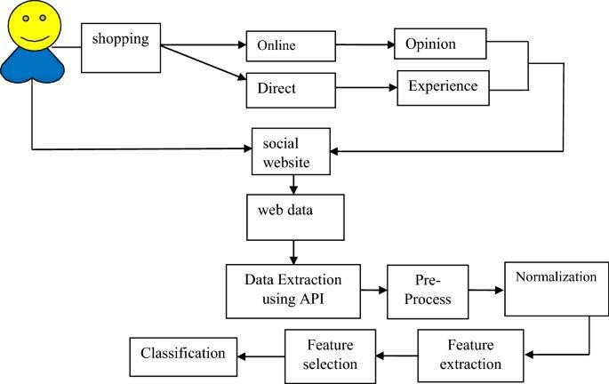
BLOCK DIAGRAM

Slide 5
SOURCE CODE
FROM TEXTBLOB IMPORT TEXTBLOB
# SAMPLE MARKETING TEXT DATAMARKETING_DATA = [ "I LOVE THIS PRODUCT, IT'S AMAZING!", "THE CUSTOMER SERVICE IS TERRIBLE.", "THIS AD CAMPAIGN IS SO CREATIVE AND ENGAGING.", "THE PRODUCT QUALITY IS DISAPPOINTING.", "I HAD A GREAT EXPERIENCE WITH THIS BRAND.",]
# ANALYZE SENTIMENT FOR EACH TEXTSENTIMENTS = []FOR TEXT IN MARKETING_DATA: ANALYSIS = TEXTBLOB(TEXT) SENTIMENT = ANALYSIS.SENTIMENT.POLARITY # RANGE FROM -1 (NEGATIVE) TO 1 (POSITIVE) SENTIMENTS.APPEND(SENTIMENT)
# CLASSIFY SENTIMENT BASED ON POLARITYDEF CLASSIFY_SENTIMENT(SENTIMENT):
IF SENTIMENT > 0: RETURN "POSITIVE"
ELSE SENTIMENT < 0: RETURN "NEGATIVE“
ELSE: RETURN "NEUTRAL"CLASSIFIED_SENTIMENTS = [CLASSIFY_SENTIMENT(S) FOR S IN SENTIMENTS]
# DISPLAY RESULTSFOR I, TEXT IN ENUMERATE(MARKETING_DATA): PRINT(F"TEXT: {TEXT}") PRINT(F"SENTIMENT: {CLASSIFIED_SENTIMENTS[I]} (POLARITY:
{SENTIMENTS[I]:.2F})") PRINT()
# CALCULATE OVERALL SENTIMENT DISTRIBUTIONPOSITIVE_COUNT = CLASSIFIED_SENTIMENTS.COUNT("POSITIVE")NEGATIVE_COUNT =
CLASSIFIED_SENTIMENTS.COUNT("NEGATIVE")NEUTRAL_COUNT = CLASSIFIED_SENTIMENTS.COUNT("NEUTRAL")PRINT(F"OVERALL SENTIMENT DISTRIBUTION:")
PRINT(F"POSITIVE: {POSITIVE_COUNT}") PRINT(F"NEGATIVE: {NEGATIVE_COUNT}") PRINT(F"NEUTRAL: {NEUTRAL_COUNT}")

Slide 6
Content for project phase 2
Explore advanced techniques like fine-tuning pre- trained sentiment analysis models (BERT, RoBERTa) for more accurate sentiment predictions.
Dataset
Link: https://www.kaggle.com/datasets/crowdflower/twitter- airline-sentiment

Slide 7
BERT Embeddings
BERT is a traditional SOTA transformer architecture published by Google Research which uses bidirectional pretraining . The importance of using BERT is that it has 2 important aspects:
Msked Language Model (MLM)
Next Sentence Prediction(NSP)
The bidirectional pre-training is essentially helpful to be used for any tasks. The Huggingface implementation is helpful for fine-tuning BERT for any language modelling task. The BERT architecture falls under an encoder-decoder(Transformer) model as follows:

Slide 8
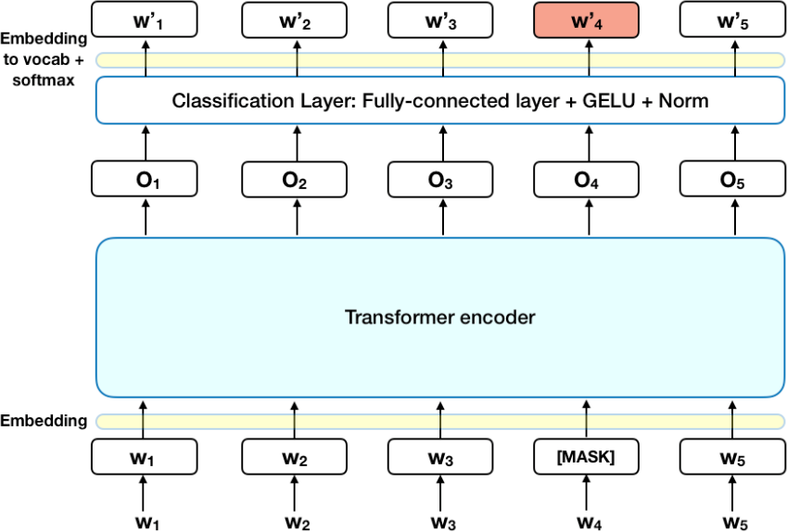

Slide 9
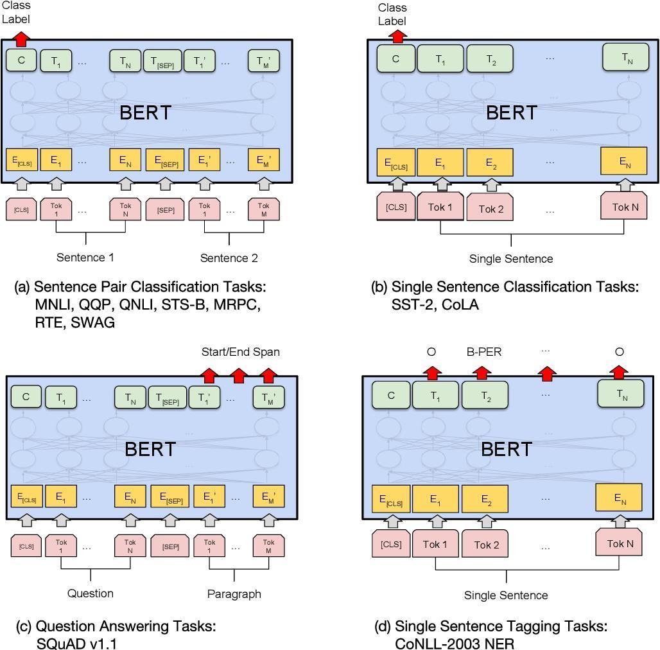
For fine-tuning and pre-training for different downstream tasks like Q/A, Classification, Language Modelling, Multiple Choice, NER etc. different layers of the BERT are used.

Slide 10
Finetuning BERT for Embeddings
For finetuning, it is to be kept in mind, there are many ways to do this. We are using BERT from Huggingfacrepository while it can also be used from TF-HUB or from Google-Research repository. The reason for using HuggingFace is that the same codebase is applicable for all language models. The 3 most important input features that any language model asks for is:
input_ids
attention_masks
token_ids
Let us first try to analyse and understand how BERT tokenizers, and model can be used in this context. The BERT documentation provides an outline of how to use BERT tokenizers and also modify it for downstream tasks.
Generally by virtue of transfer learning through weight transfer, we use pretrained BERT
models from the list. This allows us to finetune it to extract only the embeddings. Since we are using Keras, we have to build up a small model containing an Input Layer and apply the tokenized(encoded) input ids, attention masks as input to the pretrained and loaded BERT model.This is very similar to creating a very own classification model for BERT using Keras/Tensorflow, but since we will be needing only the Embeddings it is safe to extract only the sentence vectors in the last layer of the model output. In most of the cases , we will see that the dimensions of the output vector is (x,768) where x depends on the number of tokenized input features. For this we extract the [CLS] tokenized feature from the ouput to just extract the sentence embeddings.

Slide 11
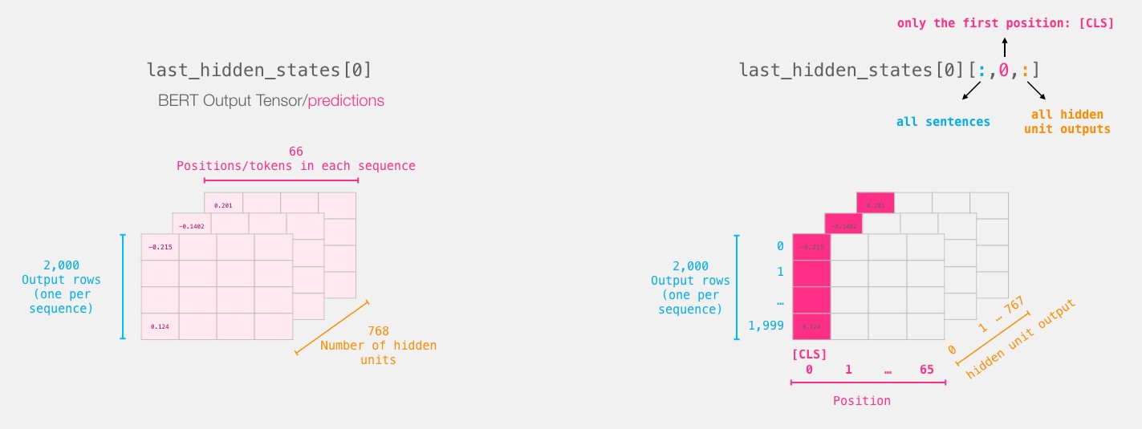

Slide 12
Some important resources which may be helpful:
Blog
Extensive Nice Blog
Good Kernel
In [1]:
#tokenize and encode the inputs
import transformers from transformers import BertTokenizer,TFBertModel tokenizer = transformers.BertTokenizer.from_pretrained('bert-large- uncased', do_lower_case=True) bert_model = transformers.TFBertModel.from_pretrained('bert-large- uncased') def bert_encode(data,maximum_length):
input_ids = [] attention_masks = []

Slide 13
for i in range(len(data)):
encoded = tokenizer.encode_plus(
data[i], add_special_tokens=True, max_length=maximum_length, pad_to_max_length=True,
return_attention_mask=True,
)
input_ids.(encoded['input_ids’]) attention_masks.append(encoded['attention_mask’])
return np.array(input_ids),np.array(attention_masks)
train_input_ids,train_attention_masks = bert_encode(train_df['review'][:5],1000)

Slide 14
Some layers from the model checkpoint at bert-large-uncased were not used when initializing TFBertModel: ['mlm cls', 'nsp cls’]
- This IS expected if you are initializing TFBertModel from the checkpoint of a model trained on another task or with another architecture (e.g. initializing a BertForSequenceClassification model from a BertForPreTraining model).
- This IS NOT expected if you are initializing TFBertModel from the checkpoint of a model that you expect to be exactly identical (initializing a BertForSequenceClassification model from a BertForSequenceClassification model). All the layers of TFBertModel were initialized from the model checkpoint at bert-large-uncased.
If your task is similar to the task the model of the checkpoint was trained on, you can already use
TFBertModel for predictions without further training.
Truncation was not explicitly activated but `max_length` is provided a specific value, please use
`truncation=True` to explicitly truncate examples to max length. Defaulting to 'longest_first' truncation strategy. If you encode pairs of sequences (GLUE-style) with the tokenizer you can select this strategy more precisely by providing a specific strategy to `truncation`.
/opt/conda/lib/python3.7/site-packages/transformers/tokenization_utils_base.py:2142: FutureWarning: The `pad_to_max_length` argument is deprecated and will be removed in a future version, use `padding=True` or `padding='longest'` to pad to the longest sequence in the batch, or use `padding='max_length'` to pad to a max length. In this case, you can give a specific length with
`max_length` (e.g. `max_length=45`) or leave max_length to None to pad to the maximal input size
of the model (e.g. 512 for Bert). FutureWarning,

Slide 15
Roberta Model
Roberta Model is a robust and large model built by Facebook Research, to alleviate undertrained nature of BERT. It trains in much larger mini-batch sizes. This provides a good model of how to train Roberta on Google cloud.The original paper can be found here, and the model architecture is provided.
Resources:
Blog
Blog-2

Slide 16
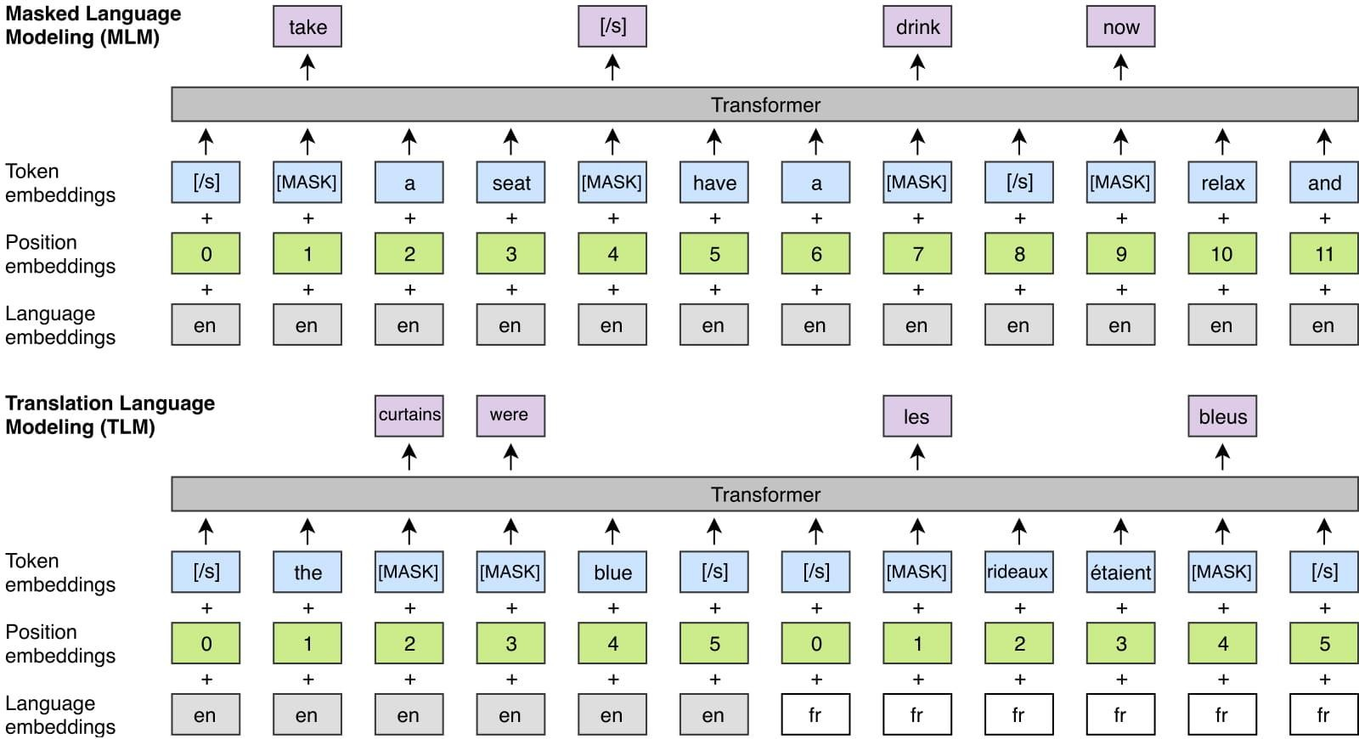

Slide 17
##Roberta Embeddings from transformers import AutoTokenizer, pipeline, TFRobertaModel roberta_features1=transformer_embedding('roberta- base',z[0],TFRobertaModel) roberta_features2=transformer_embedding('roberta- base',z[1],TFRobertaModel) distance=1- cosine(roberta_features1[0],roberta_features2[0]) print(distance) plt.plot(roberta_features1[0]) plt.plot(roberta_features2[0]) plt.show()
Some layers from the model checkpoint at roberta-base were not used when initializing TFRobertaModel: ['lm_head'] - This IS expected if you are initializing TFRobertaModel from the checkpoint of a model trained on another task or with another architecture (e.g. initializing a BertForSequenceClassification model from a BertForPreTraining model).

Slide 18
This IS expected if you are initializing TFRobertaModel from the checkpoint of a model trained on another task or with another architecture (e.g. initializing a BertForSequenceClassification model from a BertForPreTraining model).
- This IS NOT expected if you are initializing TFRobertaModel from the checkpoint of a model that you expect to be exactly identical (initializing a BertForSequenceClassification model from a BertForSequenceClassification model).
All the layers of TFRobertaModel were initialized from the model checkpoint at roberta-base.
If your task is similar to the task the model of the checkpoint was trained on, you can already use TFRobertaModel for predictions without further training.
0.9966970127889705

Slide 19
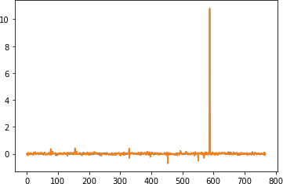

Slide 20
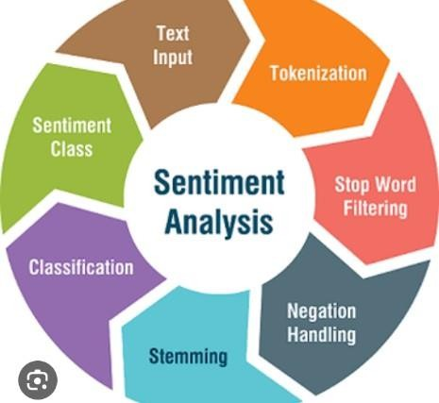

Slide 21
Introduction
Sentiment analysis, also referred to as opinion mining, is an approach to natural language processing (NLP) that identifies the emotional tone behind a body of text. This is a popular way for organizations to determine and categorize opinions about a product.
Examples for sendiment analysis
Sentiment analysis is a powerful tool, which can be used across industries and teams. Learn about some of the most popular sentiment analysis business applications, below:
Social media monitoring
Brand monitoring
Customer support analysis
Customer feedback analysis
Market research

Slide 22
Data Preprocessing :
Our data generally comes from a variety of different sources and is often in a variety of different formats. For
this reason, cleaning our raw data is an essential part of preparing our dataset. However, cleaning is not a simple process, as textual data often contains redundant and/or repetitive words.
Before training the model, we will perform various pre-processing steps on the dataset such as:
Removing stop words.
Removing emojis.
Removing of mentions.
Removal of numbers.
Removal of whitespaces.
Removal of duplicated rows.
Removal of unuseful columns.
Converting the text document to lowercase for better generalization.
Cleaning the ponctuation (to reduce unnecessary noise from the dataset).
Removing the repeating characters from the words along with removing the URLs/hyperlinks as they do not have any significant importance.
and much more, we will see this in detail later...
We will then performe:
Stemming : reducing the words to their derived stems.
Lemmatization : reducing the derived words to their root form known as lemma for better results.

Slide 23
Lowering Case:
Lowering case is very imprtant since it allows us to make words with same value equal. This will be very useful to reduce the dimensions of our vocabulary.
# Lowering Case :
print("=========== Before Lowering case ============\n") print("\t" + df.loc[10, "text"])
print("\n=========== After Lowering case ===========\n") df['text'] = df['text'].str.lower()
print("\t" + df.loc[10, "text"])
=========== Before Lowering case ============ spring break in plain city... it's snowing

Slide 24
=========== After Lowering case ===
========
spring break in plain city... it's snowing
Lower case was successfully applied to our data Removal of Mentions:
In social media, Mentions are used to call/mention another user into our post. Generally, mentions don't have an added value to our model. So we will remove them.
A mention has a special pattern: @UserName, So we will remove all string which starts with @

Slide 25
# Removal of Mentions:
## Creating a fucntion that will be applied to our datset :
def RemoveMentions(text):
text_ = re.sub(r"@\S+", "", text) return text_
## Applying the function to each row of the data
print("=========== Before Removing M entions ============\n")
print("\t" + df.loc[5, "text"])
print("\n=========== After Removing Mentions ===========\n")
df["text"] = df["text"].apply(Remove Mentions)
print("\t" + df.loc[5, "text"])

Slide 26
=========== Before Lowering case ===
=========
spring break in plain city... it's snowing
=========== After Lowering case ===
========
spring break in plain city... it's snowing
Lower case was successfully applied to our data Removal of Mentions:
In social media, Mentions are used to call/mention another user into our post. Generally, mentions don't have an added value to our model. So we will remove them.
A mention has a special pattern: @UserName, So we will remove all string which starts with @

Slide 27
# Removal of Mentions:
## Creating a fucntion that will be applied to our datset :
def RemoveMentions(text):
text_ = re.sub(r"@\S+", "", text) return text_
## Applying the function to each row of the data print("=========== Before Removing M
entions ============\n") print("\t" + df.loc[5, "text"]) print("\n=========== After Removing Mentions ===========\n")
df["text"] = df["text"].apply(Remove Mentions) print("\t" + df.loc[5, "text"])
=========== Before Removing Mentions
============
@kwesidei not the whole crew
=========== After Removing Mentions =========== not the whole crew

Slide 28
Removal of Mentions was successfully applied to our data Removal of Special Characters:
Special characters are every where, since we have punctuation marks in our tweets. In order to treat, for example, hello! and hello in the same way. we have to remove the punctuation mark
# Defining a list containing punctuation signs of english :
punctuations_list = string.punctuation
## Defining that will be applied to our datset :
def RemovePunctuations(text): transformator = str.maketrans ('', '', punctuations_list)
return text.translate(transformator)

Slide 29
## Applying the fucntion to all rows : print("=========== Before Removing Punctuations =============\n")
print("\t" + df.loc[10, "text"]) print("\n=========== After Removing
Punctuations \===========\n")
df["text"] = df["text"].apply(RemovePunctuations)
print("\t" + df.loc[10."text"])
=========== Before Removing Punctuations ============= spring break in plain city...
it's snowing
=========== After Removing Punctuations \===========
spring break in plain city its snowing

Slide 30
Removal of Stop words:
Stopwords are the most common words in any natural language. For the purpose of analyzing text data and building NLP models, these stopwords might not add much value to the meaning of the document.
Generally, the most common words used in a text are “the”, “is”, “in”, “for”, “where”, “when”, “to”, “at” etc.
Consider this text string – “There is a pen on the table”. Now, the words “is”, “a”, “on”, and “the” add no meaning to the statement while parsing it. Whereas words like “there”, “book”, and “table” are the keywords and tell us what the statement is all about.

Slide 31
Loading the Dataset :
In order to build our classifier model, we need a dataset which contains a huge number of tweets and the corresponding feeling being expressed at.
In any project related to the manipulation and analysis of data, we always start by collecting the data on which we are going to work. In our case, we will import our data from a .csv file. The dataset provided is the Sentiment140 Dataset which consists of 1,600,000 tweets that have been extracted using the Twitter API.
The various columns present in the dataset are:
target: the polarity of the tweet (positive or negative)
ids: Unique id of the tweet
date: the date of the tweet
flag: It refers to the query. If no such query exists then it is NO QUERY.
user: It refers to the name of the user that tweeted
text: It refers to the text of the tweet

Slide 32
Input:
# Importing the dataset : DATASET_COLUMNS=['target','ids','date','flag','user','text'] DATASET_ENCODING = "ISO-8859-1“
Df=pd.read_csv('../input/tweets/training.1600000.processed.noemotic on.csv', encoding=DATASET_ENCODING, names=DATASET_COLUMNS)
# Display of the first 5 lines : df.sample(5)

Slide 33
Output
 | Target | Ids | Date | Flag | User | Text
553277 | 0 | 2203589156 | Wed Jun 17 00:04:43 PDT 2009 | NO_QUERY | Ausste | Art Center assignment due in two weeks, Im fee...
1077806 | 4 | 1967737627 | Fri May 29 20:07:22 PDT 2009 | NO_QUERY | trishysabel | theres crickets in the pepsi center. u guys ...
784549 | 0 | 2324197774 | Thu Jun 25 02:32:28 PDT 2009 | NO_QUERY | aamy23 | wishing i was at the coast, sitting by the poo...
1157521 | 4 | 1979188875 | Sun May 31 01:59:52 PDT 2009 | NO_QUERY | poposkidimita r | Leaving Zadar, heading to Zagreb this afternoon
197871 | 0 | 1971093961 | Sat May 30 06:11:43 PDT 2009 | NO_QUERY | MYCBA | in london at last. missed the connecting fligh...

Slide 34
Conclusion
Sentiment analysis is a technique used to understand the emotional tone of the text. It can be used to identify positive, negative, and neutral sentiments in a piece of writing.

Slide 35
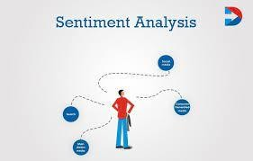
SENTIMENT ANALYSIS
Sentiment analysis is an automated process that attaches an emotional label or subjective opinion to text. For example, sentiment analysis may examine a social media post and determine that it carries a positive, negative or neutral opinion
“This was great!” “I had a horrible
experience.” The sentiments in these sentences can be inferred from certain words, such as “great” and “horrible”. By analyzing the sentiments of reviews, feedback, and other customer interactions, businesses can improve their marketing campaigns.

Slide 36
ROLE OF SENTIMENT ANALYSIS IN TRADING
Sentiment analysis plays a significant role in trading by providing valuable insights into market sentiment and helping traders make informed decisions. Here are some key roles of sentiment analysis in trading:
Market sentiment gauging
Captures sentiment shifts
News and event impact assessment
Risk management
Algorithmic trading strategies and Quantitative trading strategies

Slide 37
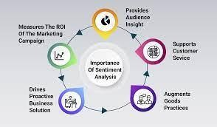
Adjusting messaging and product development
Sentiment analysis is an inexpensive way to improve messaging and product development. Knowing what customers value about a product or service can tell you what to emphasize in your promotional material. For example, if there's been a sudden and unexplained spike in sales of a certain product, you can check your positive mentions to see what customers are saying. You may find one of your products has suddenly become popular when someone posted about a feature that isn't in your other products.

Slide 38
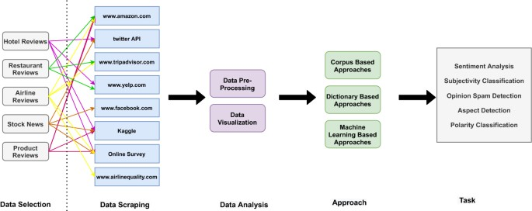

Slide 39
USES OF SENTIMENT ANALYSIS
Sentiment analysis can do wonders for any marketer. By understanding what your target audience is thinking on a scale that only sentiment analysis can achieve, you can tweak a product, campaign, and more, to meet their needs and let your customers know you’re listening
Sentiment analysis is an artificial intelligence technique that uses machine learning and natural language processing (NLP) to
analyze text for polarity of opinion (positive to negative). It’s one of
the hardest tasks of natural language processing but, with the right tools, you can gain in-depth insights from social media conversations, online reviews, emails, customer service tickets, and more

Slide 40
TOOLS FOR SENTIMENT ANALYSIS MARKETING
There are several useful and dynamic sentiment analysis tools out there that can make sentiment marketing easy and cost-effective.
Monkey Learn
Brand watch
Meltwater
Social Searcher
Repu state
Hootsuite

Slide 41
APPLICATIONS
Below are some of the top applications to help increase customer acquisition, improve customer service, and keep your clientele happy:
Social media monitoring
Analyze marketing campaign success
Gauge consumer sentiment around a new product launch
Keep an eye on your competition
Prevent PR crises
Market research
Identify influencers

Slide 42
BENEFITS
Social Media Sentiment Analysis
Brand Experience Insights
Patient Insights
Improve Customer Service
Multilingual Insight
News Trend Analysis
Real-Time Sentiment Insights
Customer Feedback

